Slide 1
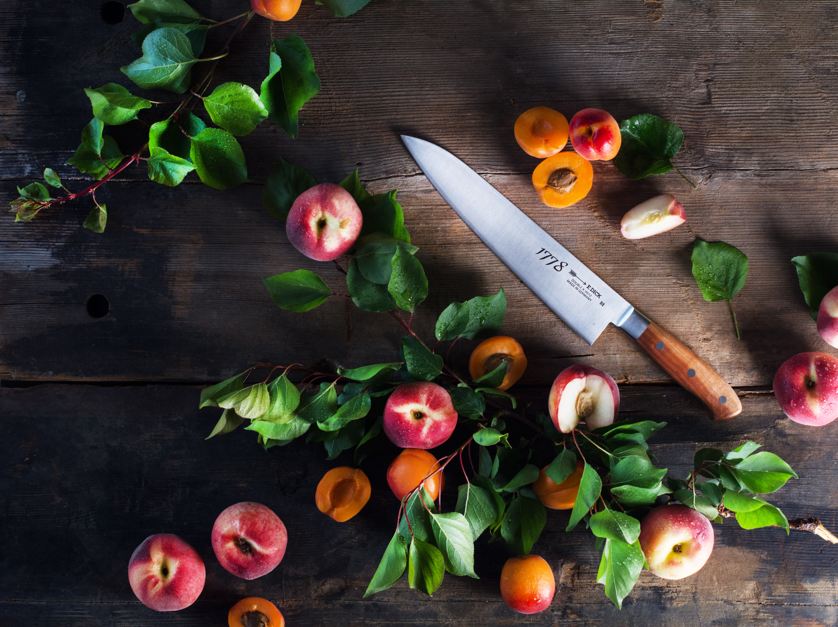
Sharp Knives are essential for your daily work
& How to keep them sharp

Slide 2
F. DICK and WORLDCHEFS
F. DICK – Proud partner of the

Slide 3
F. DICK and WORLDCHEFS
Why are sharp knives so important?
Sharp knives cut food perfectly – Blunt knives squeeze
Sharp knives are safe – Blunt knives are dangerous
Sharp knives offer a better guidance
Sharp knives offer a perfect performance during their whole “lifetime”.

Slide 4
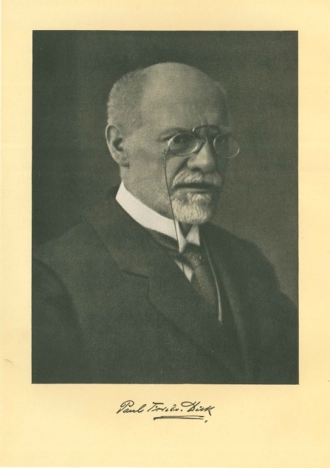
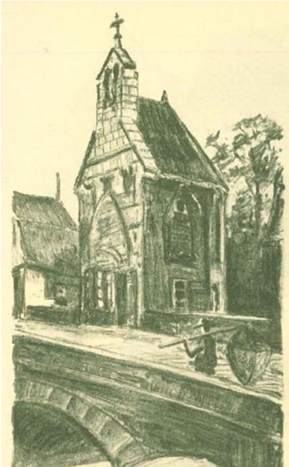
History
Tradition: A history that started two centuries ago
Founded in 1778 as file cutter workshop, Friedr. Dick in Esslingen/Germany is still family owned after 240 years.
Paul Friedrich Dick
First Factory
Former Factory

Slide 5
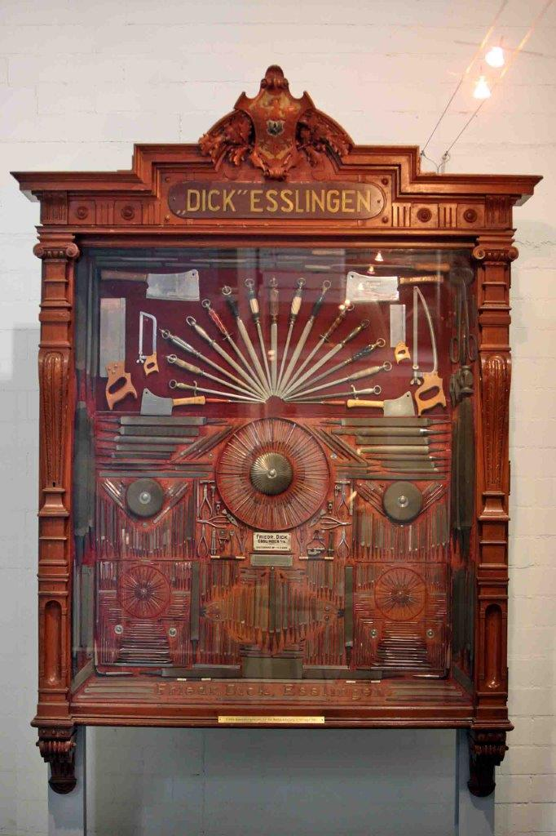
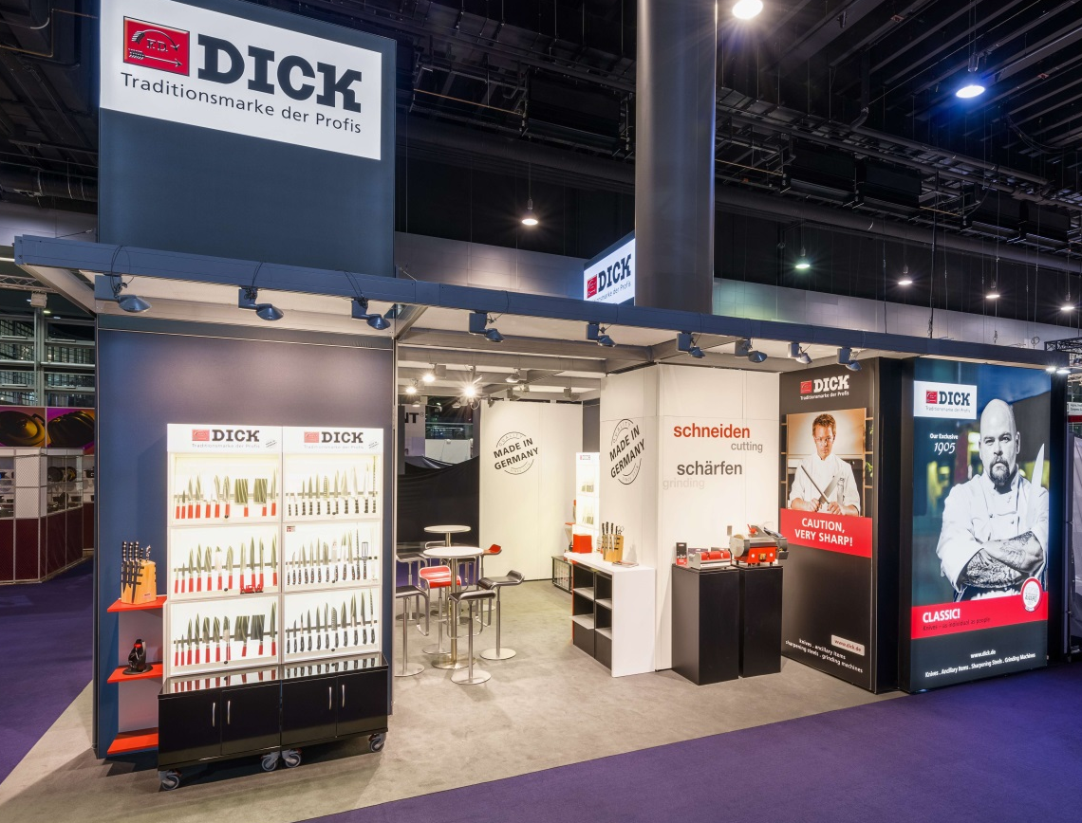
History
Tradition: Product presentation – A century ago and nowadays
World Exposition in the US, 1893
Ambiente Show in Germany, 2018

Slide 6
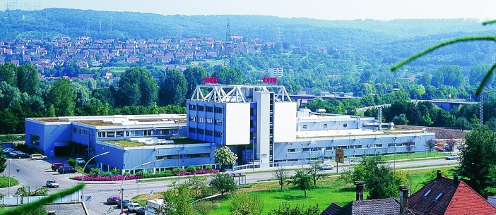
Data
The F. DICK Group nowadays:
Employees: 240
Export quota: 65 %
Group turnover: ~ 40 Mio. Euro
Factory space Deizisau: 8.000 m²
Our headquarters and production site in Deizisau/Germany

Slide 7
Data

Slide 8
Our Chef‘s Knives
Quality Factors of a Chef‘s Knife
How to spot quality and what to look out for when buying a knife

Slide 9
Quality
Quality Factors of Chef`s Knives
Knives are made out of high quality stainless steel e.g. Premier Plus made out of X50CrMoV15
Hardness of F. DICK knives: 55 – 62 HRC
Geometry of the cutting edge
Continuous tang
Ergonomic design and material of the handle
Materials conform to hygienic regulations
Result: Outstanding cutting performance

Slide 10
Quality
Quality Factor: Knife Steel
Chromium:
Another important addition, which improves the corrosion resistance, edge retention and wear resistance. 15 indicates a 15% chromium content.
X 50 Cr Mo V 15
Carbon:
most important and most influential alloying element in steel. The strength and hardenability of steel improves with an increased carbon content. 50 indicates a 0.5% carbon content
Molybdenum and vanadium:
Mo is also responsible for the corrosion resistance; the high
content reduces the steel‘s susceptibility to pitting.
V increases the wear resistance, edge retention and heat
resistance.

Slide 11
Types of Blades
Chef‘s Knives: Forged
Forged from a single piece of steel (continuous tang, not welded to the blade)
Well balanced and ergonomically designed
Manufacturing process with 45 steps.
Seamless connection of the handle and the blade.

Slide 12
Types of Blades
Chef‘s Knives: Stamped
Manufactured from highest quality alloyed steel
Manufacturing process with 16 steps.
These knives are light weighted tools for professionals.
Seamless connection of the handle and the blade.

Slide 13
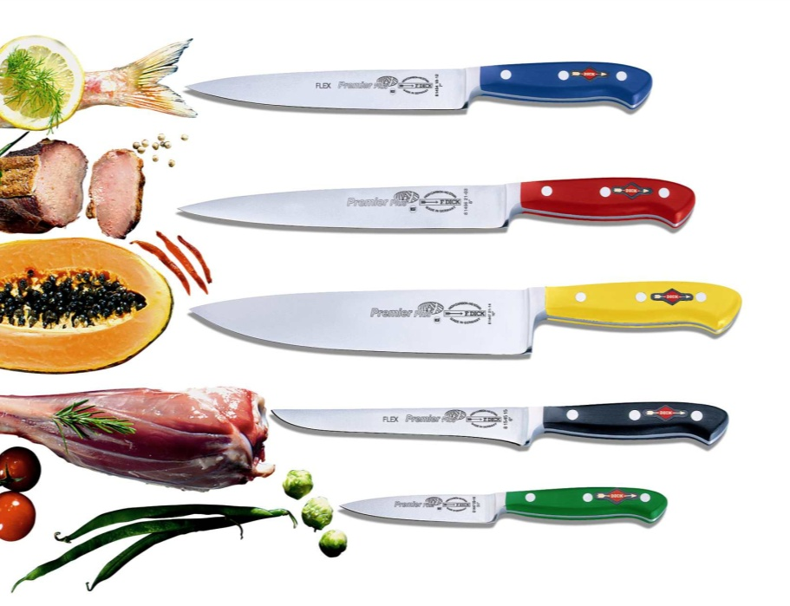
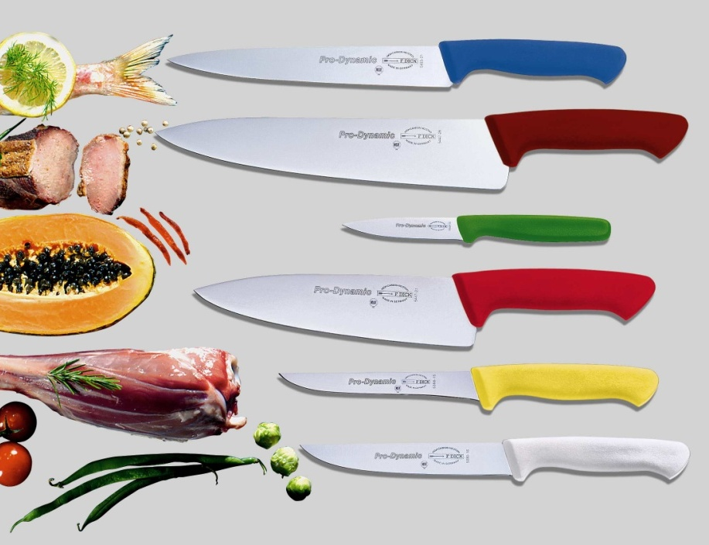
HACCP / NSF
Our Knives comply with highest standards
NSF = National Sanitation Foundation
Most of F. DICK knives are NSF certified.
HACCP = Hazard Analysis and Critical Control Points

Slide 14
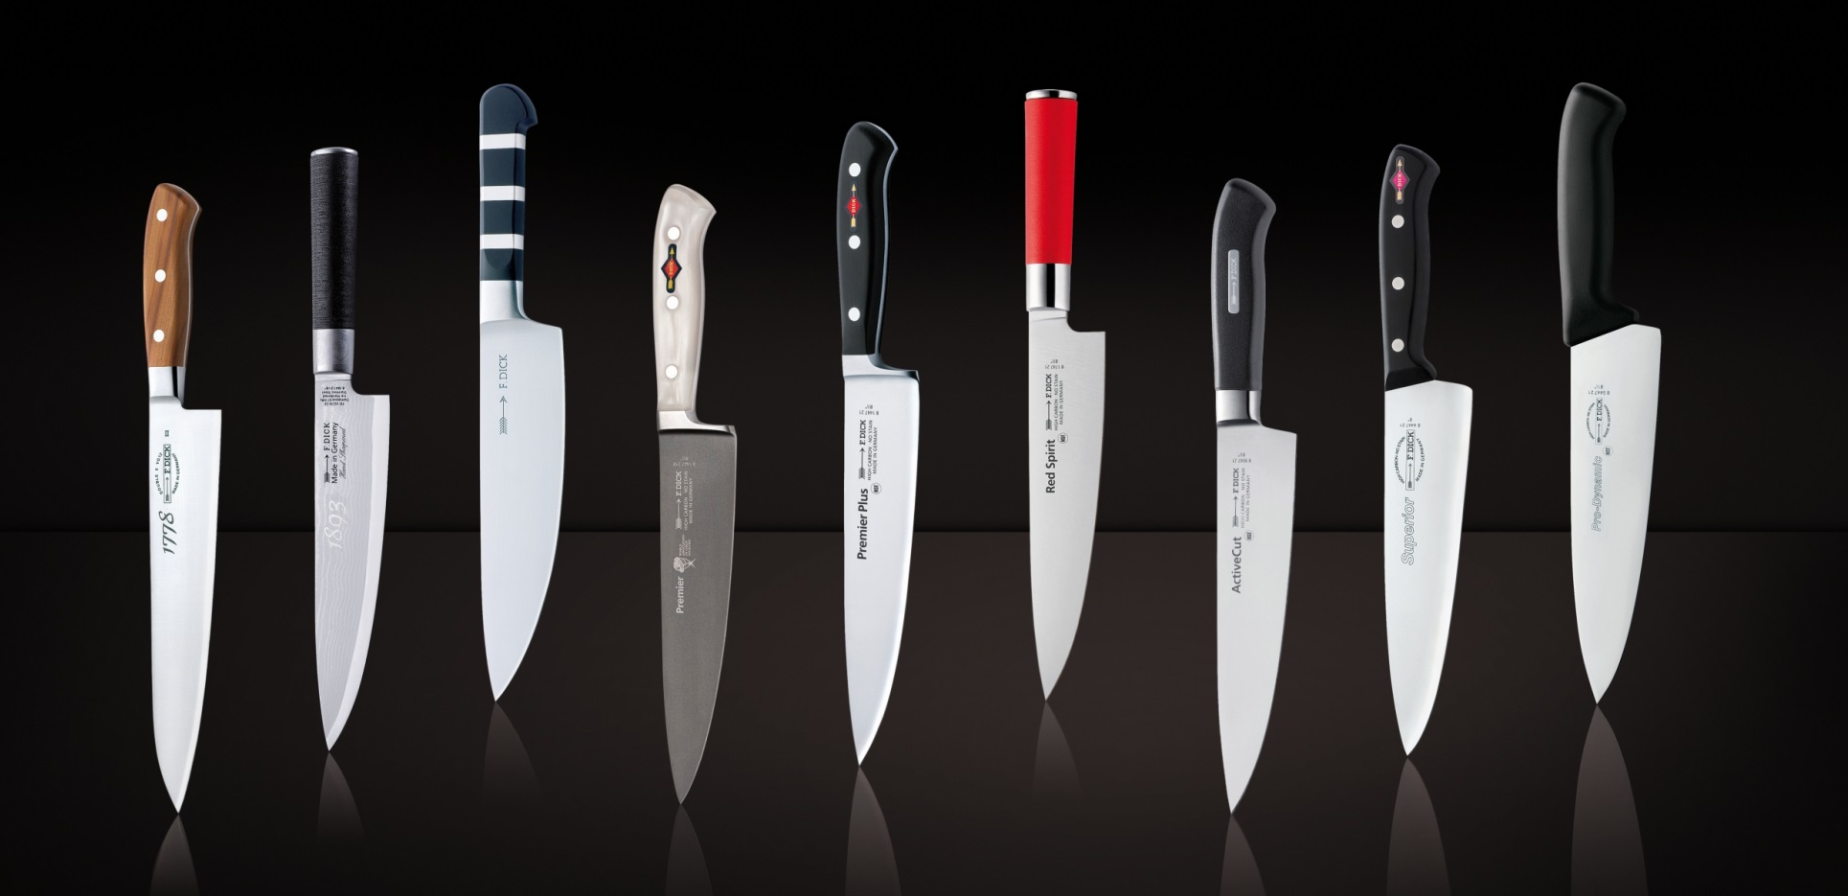
Knife Series
Our Knife Series
www.dick.de

Slide 15
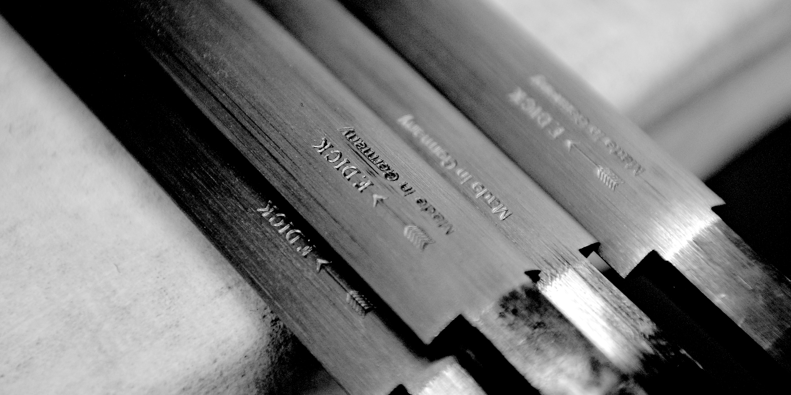
Sharpening of Knives
Traditional Sharpening Steels
Competence and tradition
of the worldwide market leader

Slide 16
Sharpening Steels
Quality Factors of our Sharpening Steels
Efficient surface protection through
hardchrome plating
Safety through high-quality
fittings
Balanced taper towards the tip of the steel
Regular serrations (cuts) for a smooth and razor sharp edge
Wear-resistant surface with
breakproof, tough core thanks to
latest hardening technology
Hardness of a sharpening steel: ~ 64 - 66 HRC

Slide 17
Sharpening Steels
The different Sharpening Steel shapes
Round shape:
Little weight. No edges, only punctual contact area for the knife
Oval shape:
Contact over a large area and thus effective sharpening result
Flat oval shape:
Offers largest contact area for the edge,
extremely effective sharpening result
Special flat oval shape – MulitCut/Multiron:
Like shape above but even higher abrasion because of
very deep and rough cuts
Square shape:
Combines 2 sharpening steels in one
The length of a sharpening steel depends on the length of the knife’s cutting edge

Slide 18
Sharpening Steel
The different Sharpening Steel cuts
Diamond / Titan
Standard Cut
Fine Cut / Ceramic
Rough Cut
Polished
High abrasion.
Mostly for domestic use.
Diamond or titan surface for exceptional honing.
Normal abrasion for the daily honing of the knife.
Normal, high abrasion.
Fine honing and straightening of the edge.
Low abrasion.
No abrasion. Only for polishing and straightening the cutting edge.
For knives with a high hardness.
Very high abrasion.

Slide 19
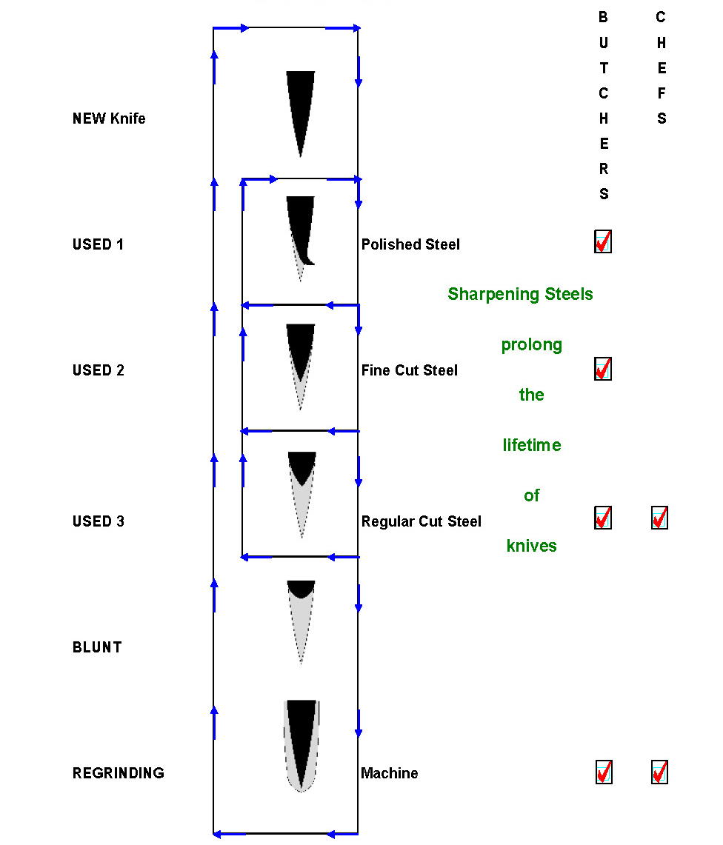
Cutting edge
What happens, when using a traditional sharpening steel:

Slide 20
Sharpening Steels
How to use our traditional Sharpening Steel (1)
Angle too small
Angle too big
Angle about
15°-20°

Slide 21
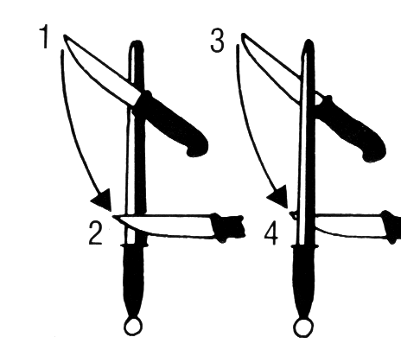
Sharpening Steels
How to use our traditional Sharpening Steel (2)
The sharpening steel and the knife’s cutting edge must touch each other at the correct place.
The steel and the knife’s cutting edge must be at the correct angle to one another.

Slide 22
Sharpening Steels
The sharpening steel variety - our DICKORON Family
DICK micro
DICK combi
DICKORON
hygienic
DICK hygienic
combi
DICKORON
DICK polish
DICK titan

Slide 23
Sharpening Steels - Substitutes
Sharpening Devices
Competence and tradition
of the worldwide market leader

Slide 24
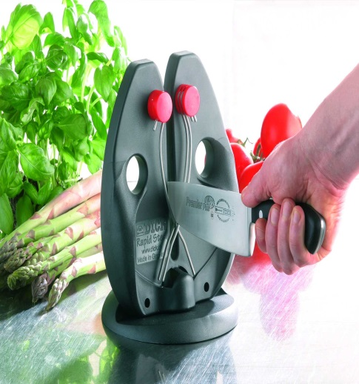
Sharpening Steels - Substitutes
Easy Sharpening Solution – The Rapid Steel action
Sharpening rods with tungsten carbide (Titan) coating
Easy to use
Always the right angle
Perfect sharpening result

Slide 25
Sharpening Steels - Substitutes
And this is how easy the Rapid Steel works:
Draw the knife with slight pressure through the rods of the sharpener.
Use the spring action of the rods without bottoming the knife blade.
Repeat 5 – 10 times – and you will have a sharp knife with a perfect, specified angle

Slide 26
Sharpening Stone
Sharpening Stone
Professional sharpening
on a sharpening stone

Slide 27
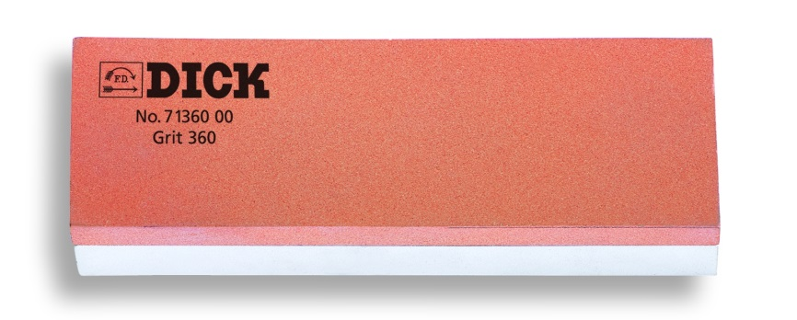
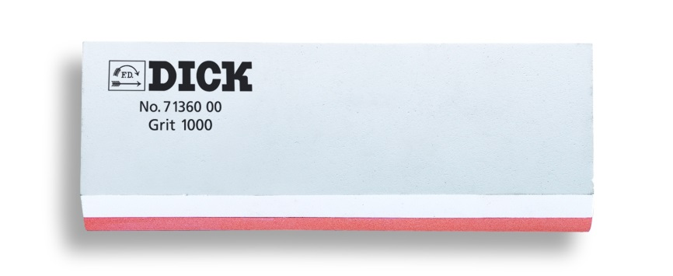
Sharpening Stone
How to use a sharpening stone
Put the stone in water for 5-10 minutes (until no bubbles can be seen) before using it.
Always usethe sharpening stone with the non-slip holder supplied.
Start with the coarser, orange side of the stone.
Wipe your stone and clean your knife carefully after the sharpening process.

Slide 28
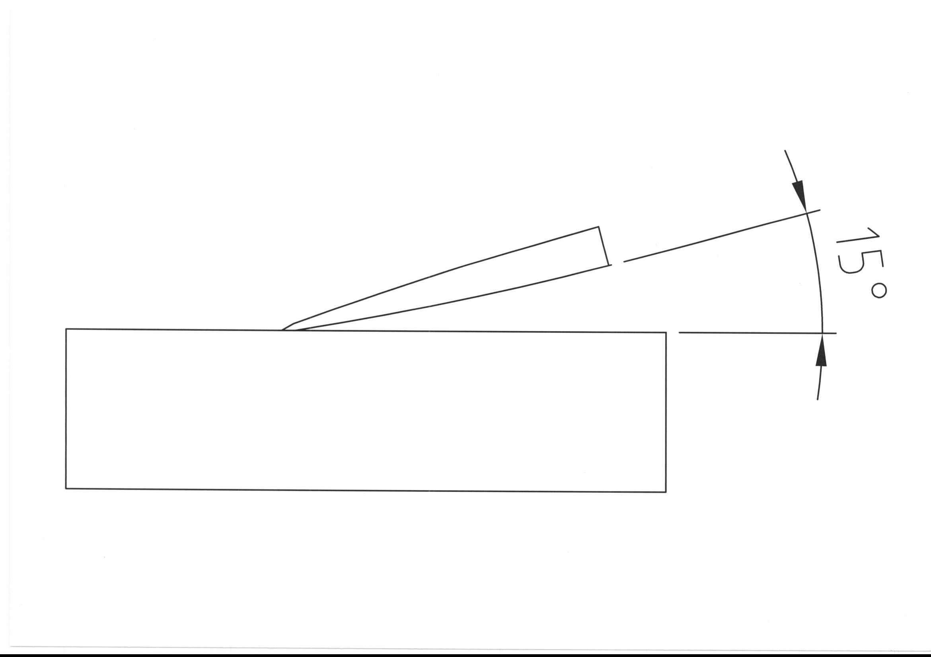
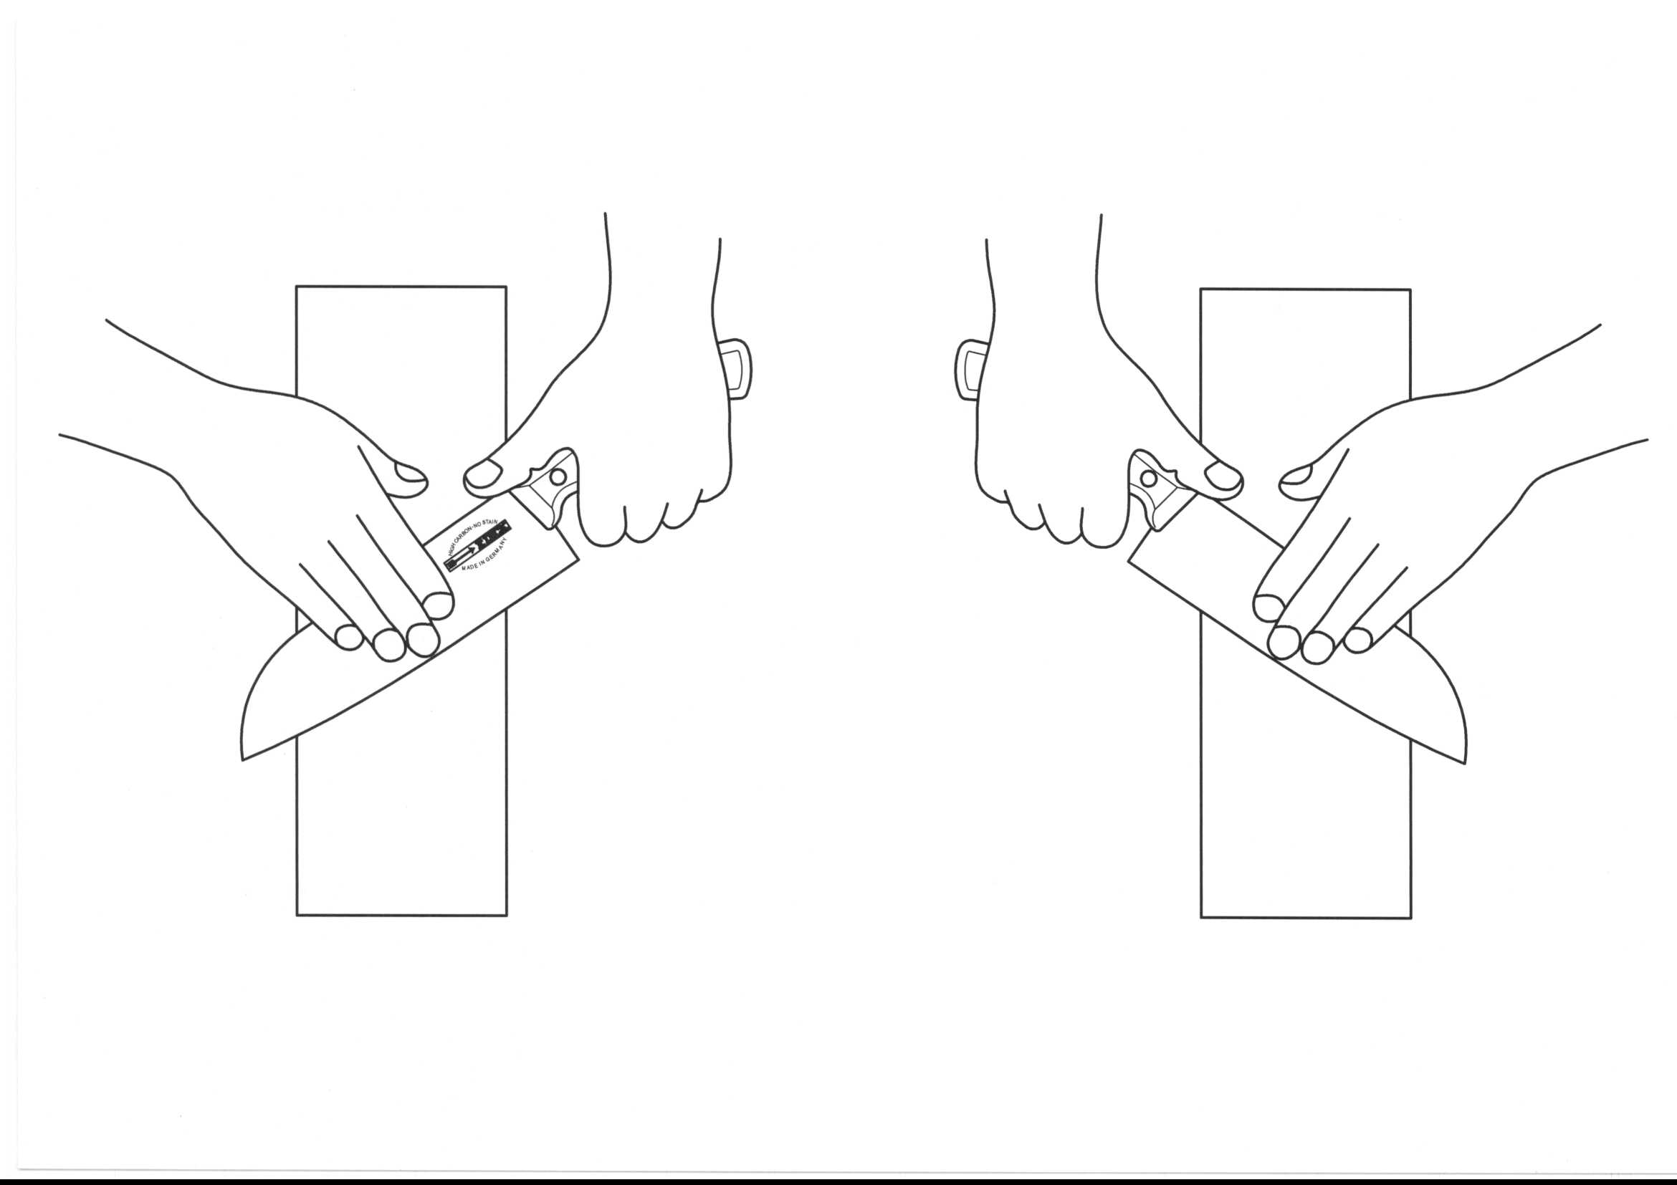
Sharpening Stone
How to use a sharpening stone
Draw the blade away from the body and back towards yourself, applying light pressure over the entire surface area of the stone. Start with the tip of the blade. Repeat until a fine burr forms.
Switch the side of the knife and repeat the process. Keep the same angle between the knife blade and the stone at all times.
Repeat the process on the fines, white side of the stone.

Slide 29
Grinding Machines
Sharpening Solutions
From time to time necessary

Slide 30
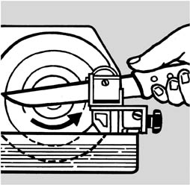
Grinding Machines
Regrinding
Grinding
Optimum grinding angle with F. DICK grinding machines

Slide 31
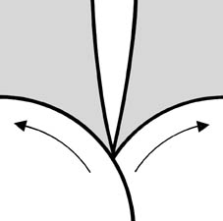
Grinding Machines
Honing
Honing
Deburring with optimum angle

Slide 32
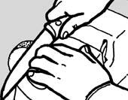
Grinding Machines
Polishing
Polishing
100% polishing of the cutting edge

Slide 33
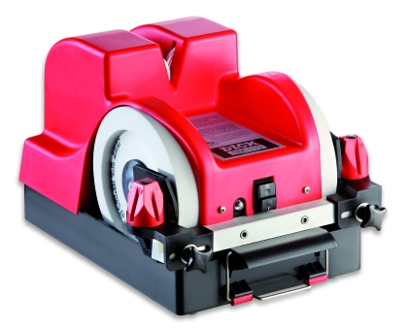
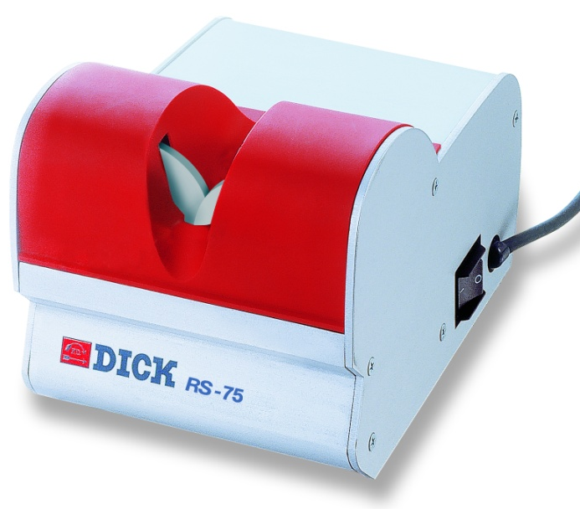
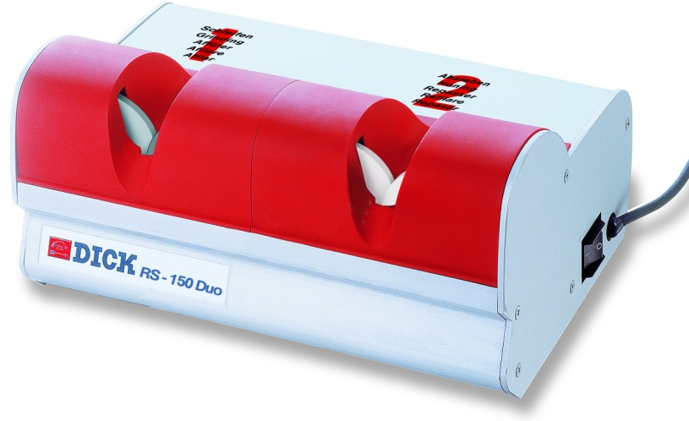
Grinding Machines
Grinding Machines for chefs in hotels & restaurants
RS-75
RS-150 Duo
SM-110
SM-111
Effective grinding and honing
Fast, safe, efficient.
Effective grinding with diamond coated wheels and reduced knife consumption
Ceramic wheels for honing
Easy to operate with perfect results
Water-cooled grinding and honing
Adjustable angle because of holding magnets for absolute safety and precise grinding
Reduced material removal – long lasting cutting edge
Low grinding costs
Professional and safe grinding, honing and polishing
SM-111: Polishing wheel for highest demands

Slide 34
Maintenance
Care, storage and transportation
Taking care of your Chef‘s Knives

Slide 35
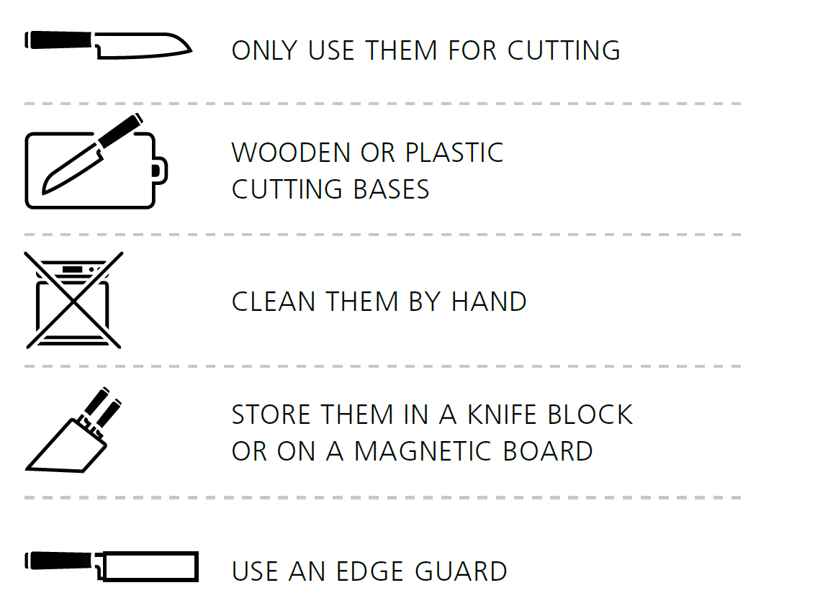
Maintenance
Care of your F. DICK Knives

Slide 36
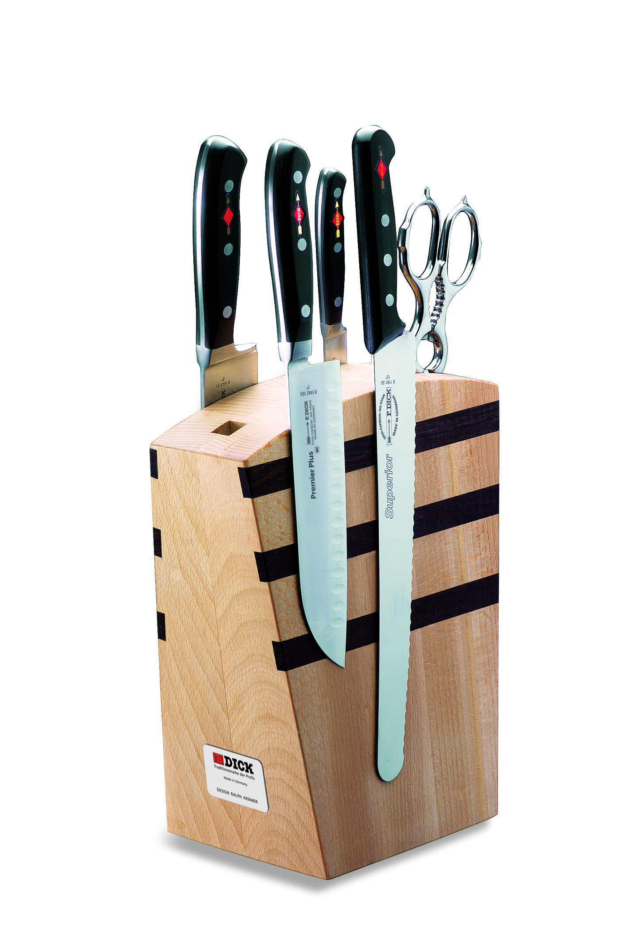
Maintenance
Storage of your F. DICK Knives

Slide 37
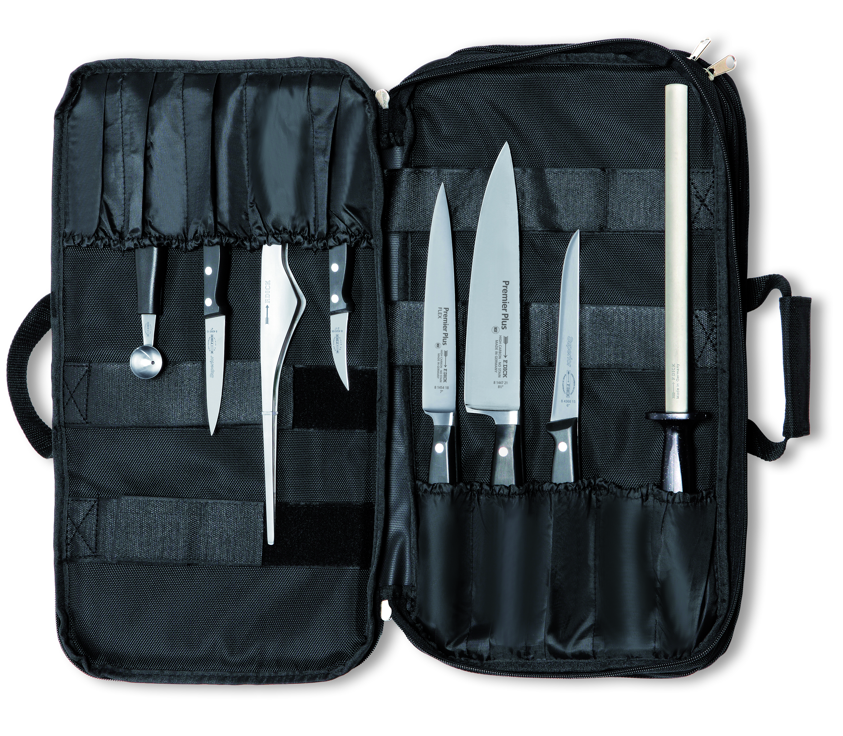
Maintenance
Transportation of your F. DICK Knives
Example: Culinary Bag with Premier Plus knives

Slide 38
Thank you!

